Slide 1
TEXT NORMALIZATION BASED ON DICTIONARY CROSS CHECK
DSC - WAVE 13
NASRUDIN YAN WIJAYA

Slide 2
BACKGROUND
Prevalence of slang words usage in Twitter among Indonesians
↓
Why are slang words usage in Twitter preferrable among Indonesians?
↓
Hypothesis: more often than not, slang word has fewer characters than its formal counterpart

Slide 3
TEXT CLEANSING PROCESS
Text and/or csv file input, e.g.
‘aduhh, aer habis’, ‘saya makan 3x’
Sentence breakdown into list of composing words, disregarding punctuation, e.g.
(‘aduhh’, ‘aer’, ‘habis’), (‘saya’, ‘makan’, ‘3x’)
Cross check & replace/leave as is each word based on dictionary e.g.
(‘aduhh’, ‘aer’, ‘habis’) --> (‘aduh’, ‘air’, ‘habis’)
(‘saya’, ‘makan’, ‘3x’) --> (‘saya’, ‘makan’, ‘tiga kali’)
Sentence rebuilt based on words replaced & words left as is words, capitalized, e.g.
‘Aduh, air habis’, ‘Saya makan tiga kali’

Slide 4
STATISTICS METHOD & E.D.A.
To test the previously stated hypothesis,
this data analysis mainly uses descriptive statistics, particularly variance & range of the character count difference between
the cleansed tweet (formal words), and
the original, uncleansed tweets (slang words).
A sample of 100 tweets will be visualized using bar charts & box plots of the character count difference, of which the value is
(cleansed tweet char count) - (original tweet char count)

Slide 5
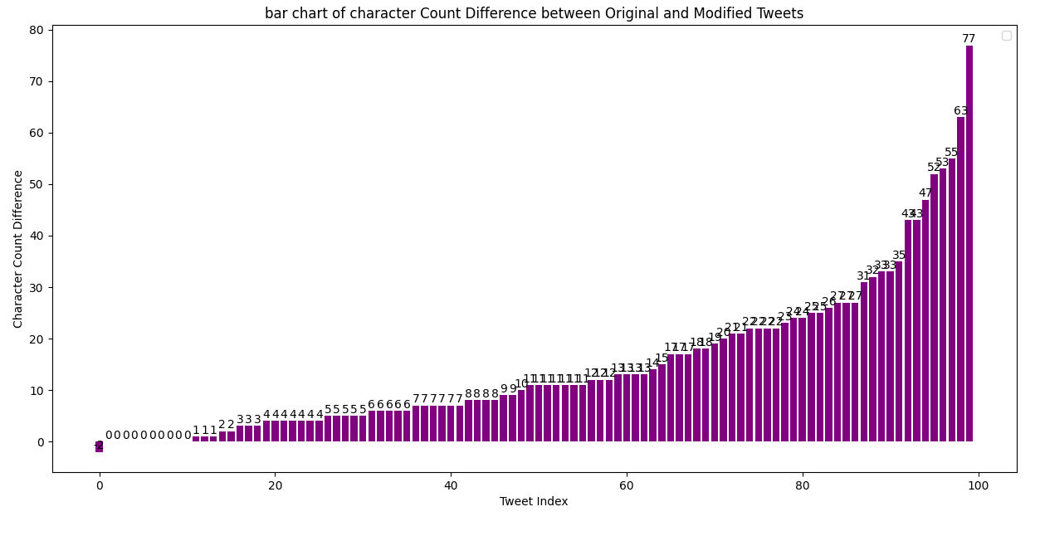
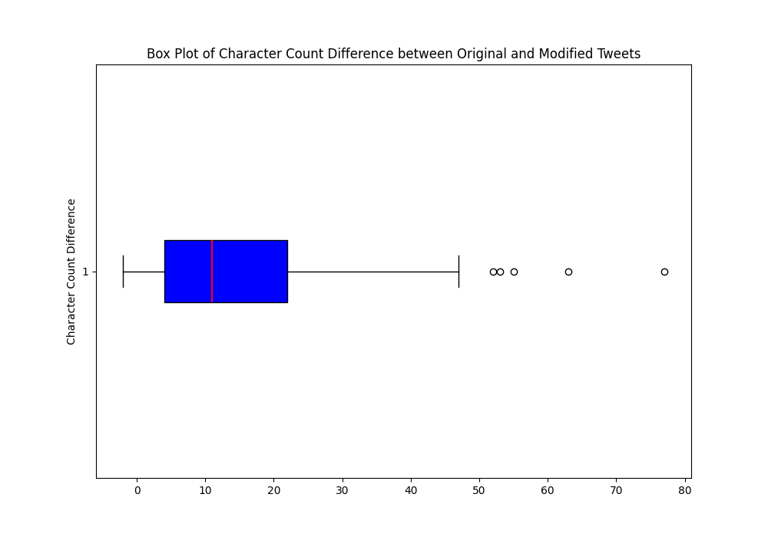
DATA VISUALIZATION
Bar charts show that the number of cleansed tweets with higher character count far outnumbers those with lower character count.
Box plot shows wider range & variance in positive number of character count difference.
Both confirms the hypothesis that more often than not, slang word has fewer characters than its formal counterpart.

Slide 6
CONCLUSION
The prevalence of slang words usage in Twitter among Indonesians is, for one, due to the factor that they require fewer characters to type, but it doesn't stop there. Slang words often also represent fluidity in language and communication. With Twitter being a social media, slang words usage among Indonesians is an extension of their communication.

Slide 7
THANK YOU
FOR YOUR ATTENTION

